Slide 1
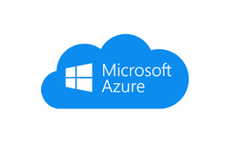




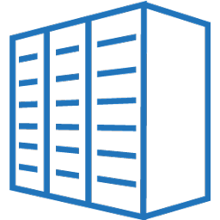

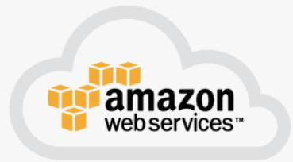

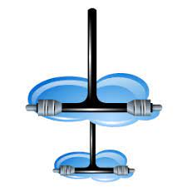
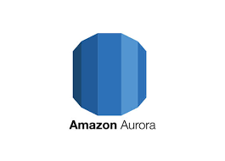
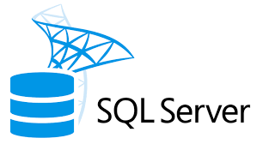

NA
APAC
Azure NA
VNET trp investment
Private Subnet
Office 365
Office 365
Data Center Vx Rail Virtual Infrastructure North America
PBI Cluster
Direct Connect
VPN Tunnel
PBI GATEWAY SERVER
PBI GATEWAY SERVER
PBI GATEWAY SERVER
PBI GATEWAY SERVER
AWS NA
VPC2 trp investment
Private Subnet
Private Subnet
AWS NA
No Database is
Outside of North
America
VPC3 Shared

Slide 2



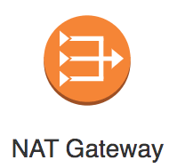

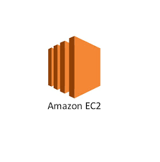
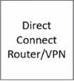
VNET trp investment
Public Subnet
Private Subnet
vpn gateway
Private Subnet
PBI Cluster
Gateway
PBI Node1 PBI Node2 PBI Node3
VP conn
Data Center
Private Subnet A22
Private Subnet A21
Subnet
VPC2 trp investment
AZ1
VPC3 trp investment
AZ2
Private Subnet
Private Subnet

